Slide 1
MemComb Sprint 4
Bassam Thomas
Danny Naum
Chris Stidham
Scott O’Neil
Nathan Hyde
David Michon
Jacob Couveau
Notes:
David

Slide 2

Firebase Hosting
Hosts our project
Deploys any changed files with ‘firebase deploy’ command
Plays nice with other Firebase services, including
Cloud Functions
Authentication
Realtime Database
Cloud Firestore
Cloud Messaging
Notes:
Scott

Slide 3
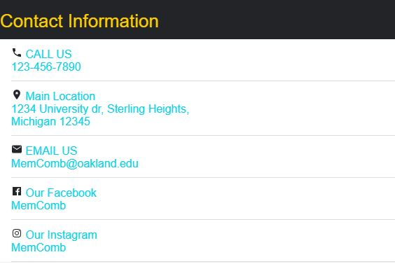
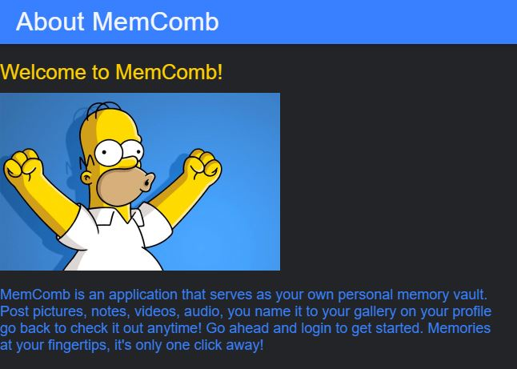
About and Contact Info Page
Creating an About page to explain the details of this app
Creating a Contact Information to how people can reach us including the Call Us, Our Main Location, Our Email, Our Facebook, and Instagram

Slide 4
Replacing Okta with Firebase Login
Had trouble integrating Firebase with Okta
Created entirely new Login UI and connected it to Firebase database
Reimplemented basic login security

Slide 5
Firebase Challenges
Storing data other than images or text
Retrieving video data for playback
Having it connect with the Okta ID’s for unique user ID’s
Implementing it with Ionic 4
Lack of overall database experience
Notes:
David

Slide 6
Looking Forward
Lots of catch-up this sprint:
Allow the upload storage, and retrieval of videos
Allow the upload, storage, and retrieval of audio
Taking the uploaded media and tying it to an event instead of user
Hide app functions behind login
Notes:
David

Slide 7
Demo

